Slide 1
Summer School – Wellbeing 26.06 – 30.06.2023

Slide 2
The title of the project: Communication and well-being in building effective international teams
Date: 26-30.06.2023
Place: Polanica Zdrój, about 100 km from Wroclaw (transport from Wroclaw to Polanica is included in the project)
Price: Free of charge

Slide 3
Communication and well-being in building effective international teams
Benefits:
Hotel and board are provided, in addition:
each participant will receive a scholarship of 450 euros per student
2 ECTS
Certificate

Slide 4
Subject of classes:
Modern leadership in organizations applying the idea of well-being
Individual and group effectiveness
Work environment supporting well-being
Transformative communication - how to learn to listen to yourself and others?
Psychological basis of employees' well-being

Slide 5
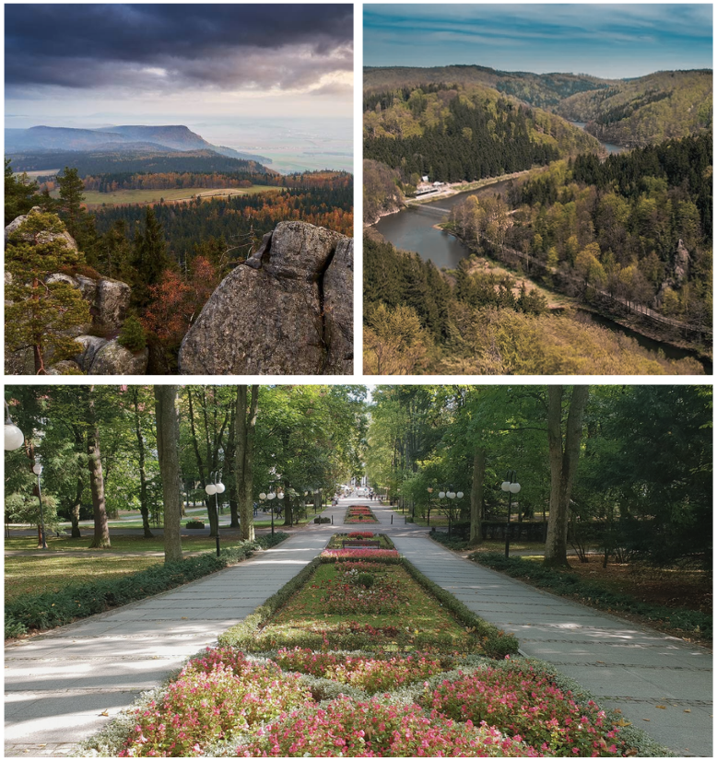
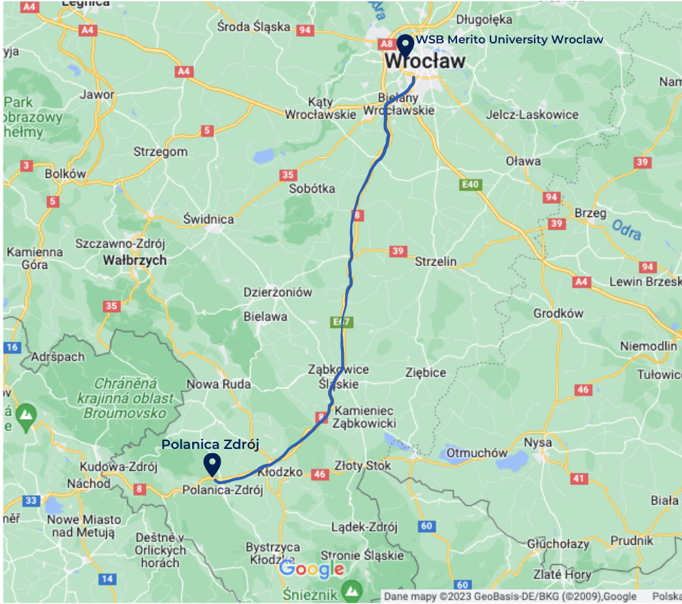
Polanica Zdrój

Slide 6
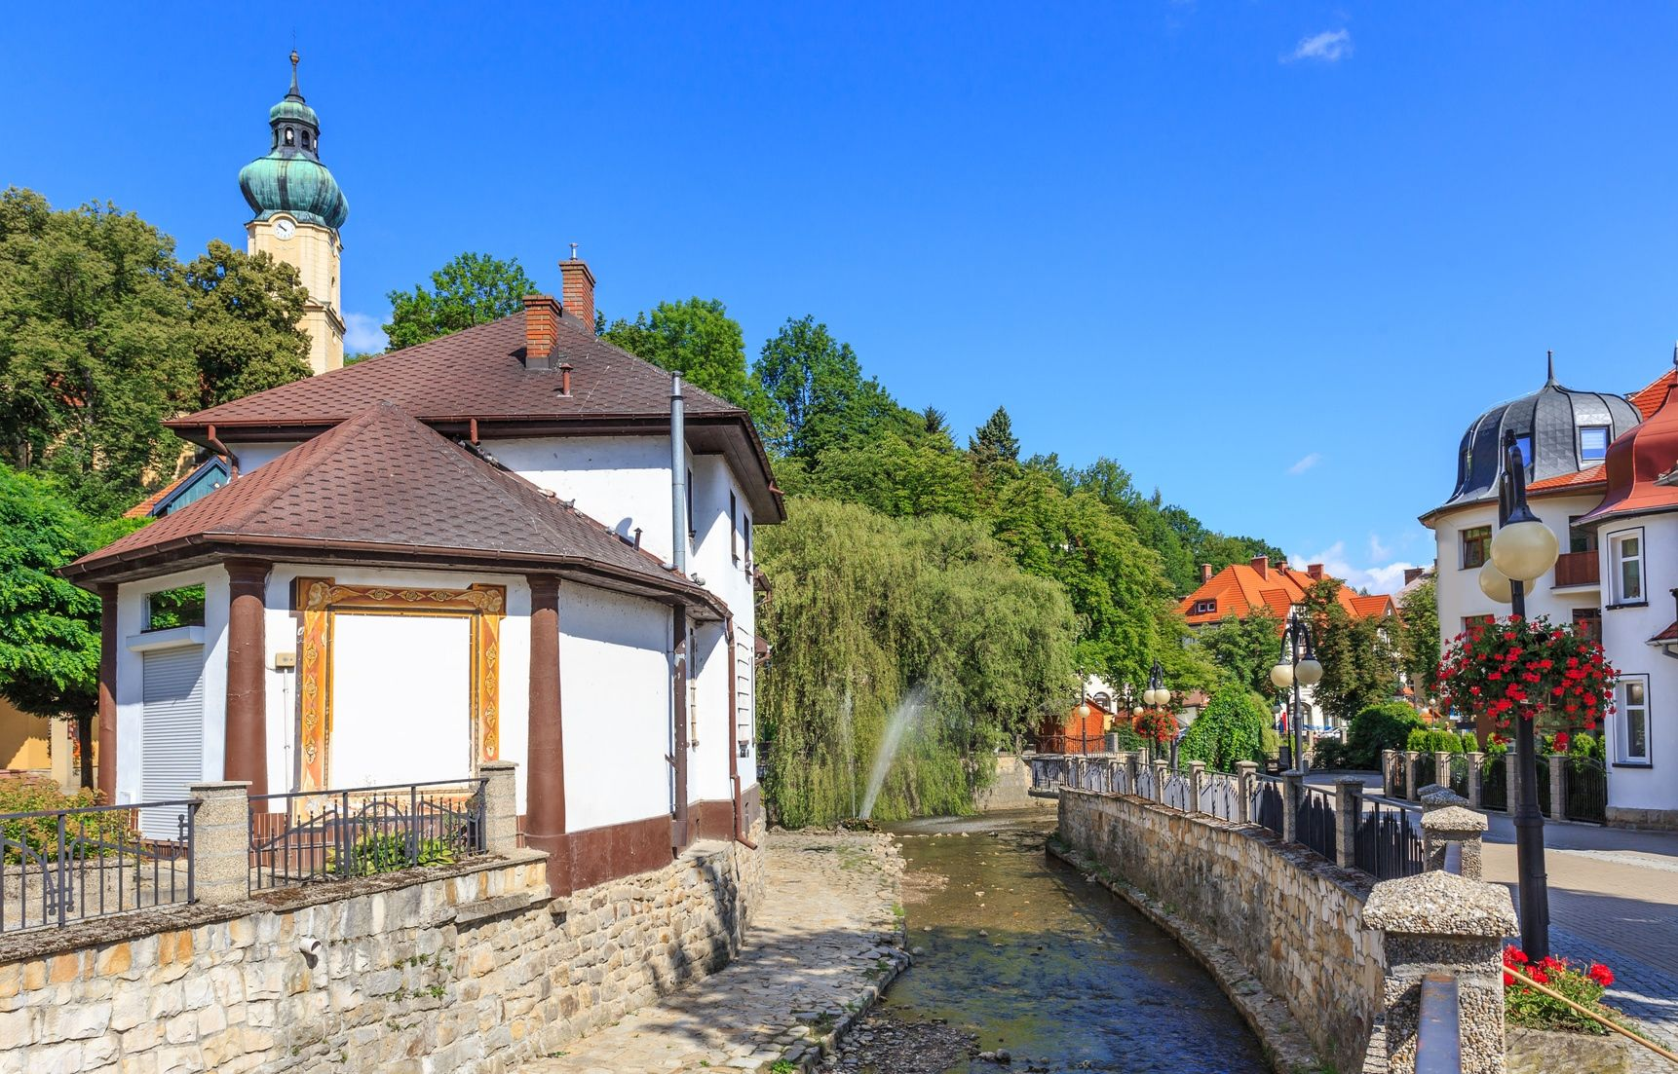
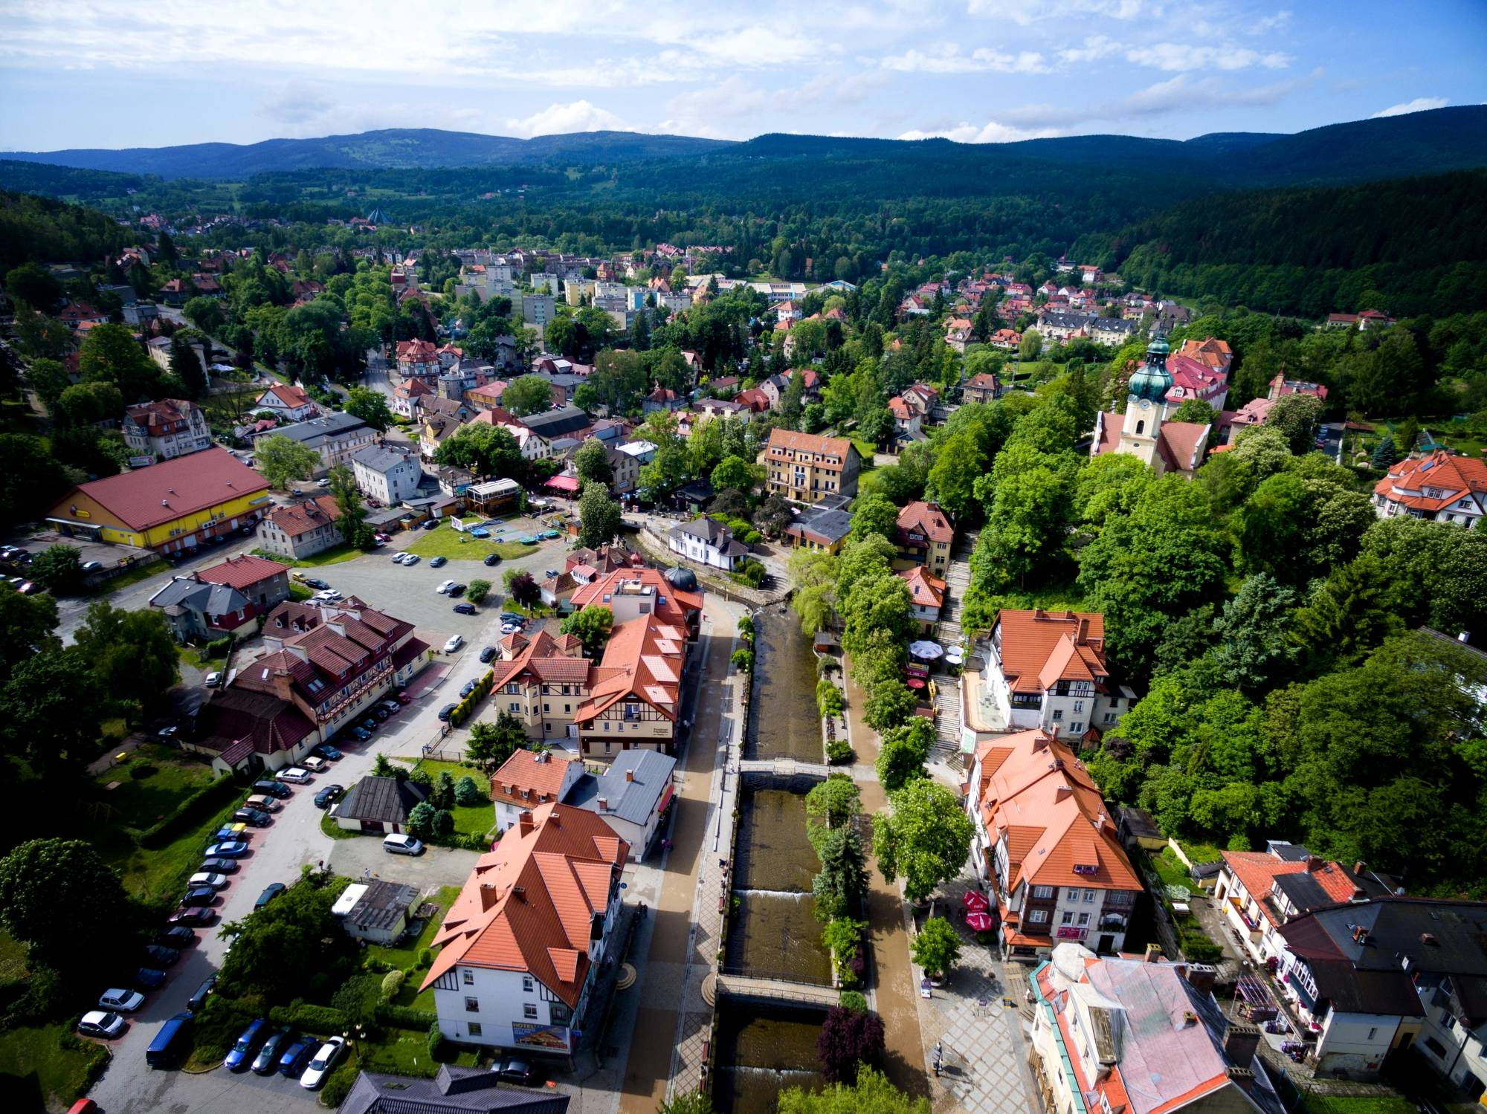
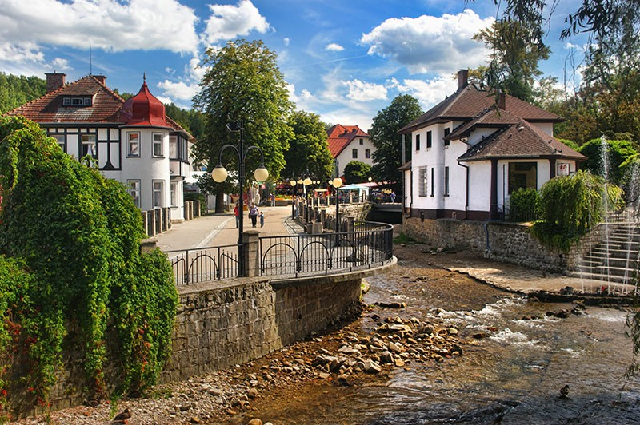
Polanica Zdrój

Slide 7
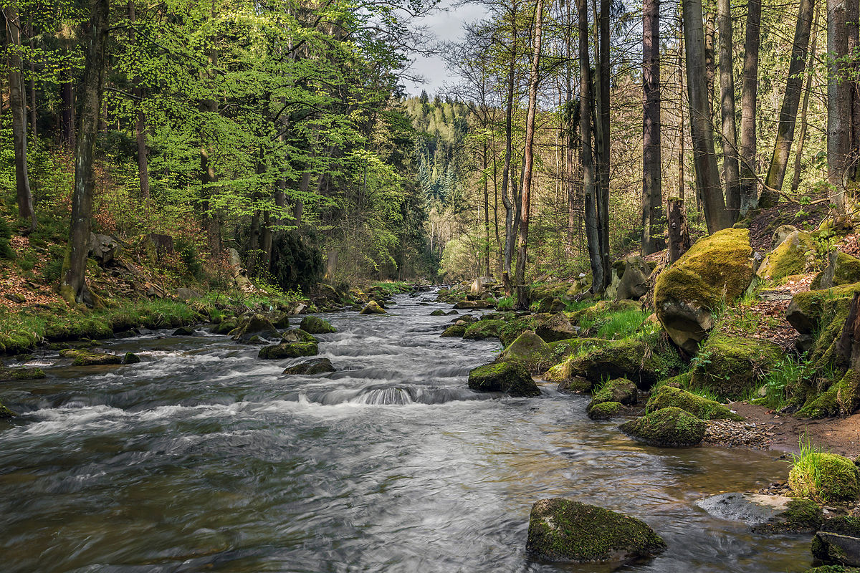
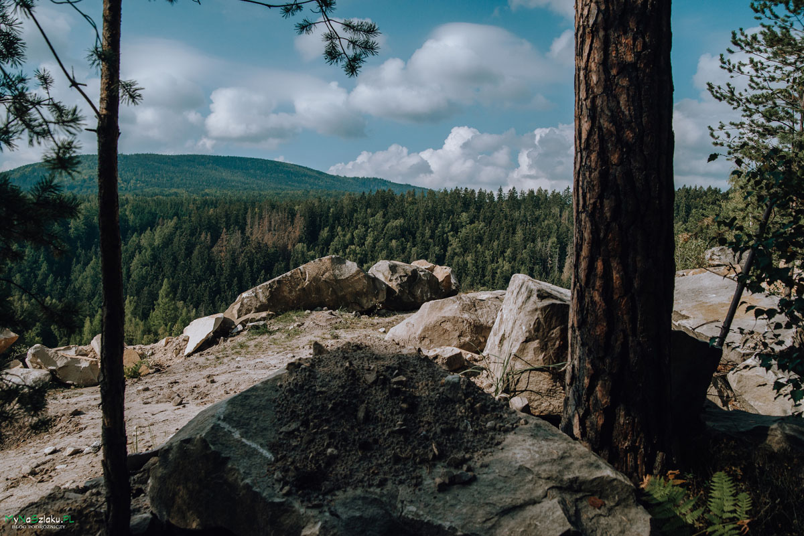
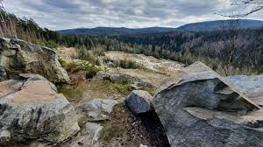
Stołowe Mountains

Slide 8
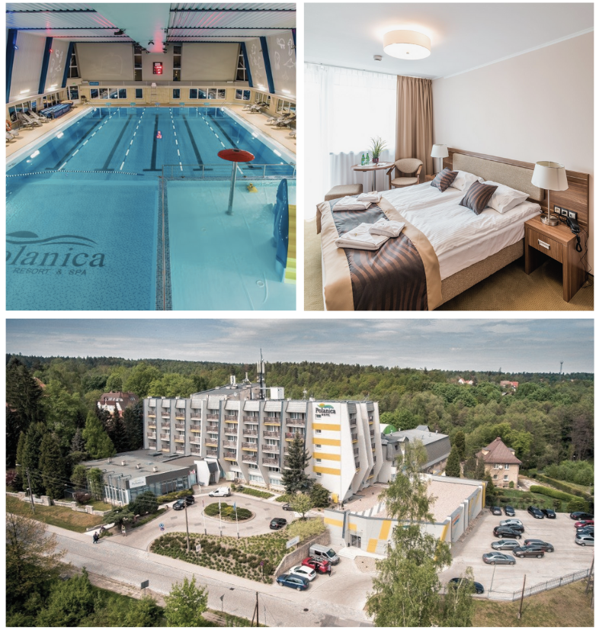
Hotel Polanica
„Hotel Polanica Resort&Spa is located in Polanica-Zdrój, a town with a rich spa tradition. The picturesque location, the revitalized Zdrojowy Park, the famous promenade and the proximity of many attractions of the Kłodzko Land guarantee a successful holiday. A full-size swimming pool in our Water Park distinguishes us among accommodation facilities. With our guests in mind, we have created a zone with massagers and geysers, a jacuzzi and a sauna zone - a steam bath, a dry sauna and a saunarium. We invite you to relax and rejuvenate in the SPA zone. For guests who value physical activity, there is a gym equipped with cardio equipment and free weights, as well as an indoor sports hall with a multifunctional sports field. The bowling club is the hotel's entertainment zone. The only such place in Polanica Zdrój. Four bowling alleys, a billiard room, a card room - all in one place”
Informacje o hotelu, pokojach i okolicy - Hotel Polanica Resort & SPA

Slide 9
Objective and form of classes
Using the concept of well-being to create effective management
of modern organizations and create the innovative potential of employees.
By participating in the project, listeners will gain knowledge
about leadership in modern organizations that use the well-being concept.
The classes will consist of 6 specialist modules including one,
popularizing Polish and participants culture.
The total duration: 34 academic hours, including 4h online, 30h on site

Slide 10
Concept outline
The innovative character of the project is to be based on a non-standard group of
recipients.
The concept of wellbeing will be used as a form of shaping employees' attitudes
and motivation.
In addition, the work methodology will be based on a nationally and culturally
diverse group.
The methodological concept of the project assumes building students' attitudes
and transferring appropriate knowledge on how, through appropriate leadership
techniques, they can cooperate, combine the potentials of various groups,
while understanding cultural values.

Slide 11
Subjects
We want to educate modern Leaders, people who function efficiently in an international environment, open
to the challenges posed by global organizations.

Slide 12
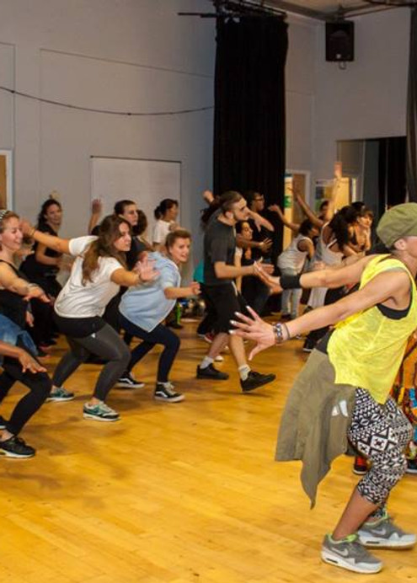
Subjects
Work environment supporting wellbeing
The pillars of the program are healthy nutrition, health knowledge, healthy body, healthy spirit and prevention.
Students will be able to experience kizomba dance classes as well as meditation, breathing and visualization practices.
In our program, we try to develop young people's self-confidence and skills necessary in the modern world, and often
overlooked in school education.

Slide 13
We use hiking and other sports activities for this purpose.
Even 20 minutes of exercise a day can reduce anxiety disorders and feelings of depression.

Slide 14
With the help participants will take on a series of confidence-building challenges that encourage them to try new things and step outside their comfort zones.

Slide 15
The culminating point is a mountain adventure, during which, using the skills acquired earlier, students will
learn to follow their own path in life.

Slide 16
Subjects
Positive needs-based communication within the organization
We will present a simple model of transformative communication. It allows you to develop your skills:
naturally making good contact (listening, speaking, moving)
building good relationships (private and professional)
dealing with emotionally charged social situations
effective and sustainable win-win conflict resolution
the ability to take care of oneself (and one's goals), others and the relationship at the same time
support and influence in an integral way, including metaprograms and values
creating solutions in difficult situations
skills needed to communicate with and within a group
We will work on models and examples from different cultural contexts, we will use interesting stories and metaphors, we
will propose exercises to be performed individually and in a group.
We work on the international Transforming Communication method by Richard Bolstad.

Slide 17
Benefits
What will the project give you:
2 ECTS
Certificate
Knowledge on how to balance different aspects of your life and how to introduce the so-called wellbeing into your life
International friendships - 25 students from different countries will participate in the project
Hotel and board are provided, in addition, each participant will receive a scholarship of 450 euros per student
Interactive form of classes
In free time:
Many opportunities for integration
Trips to the mountains
Visiting the region

Slide 18
Contact
IN CASE OF ANY QUESTIONS, FEEL FREE TO CONTACT US:
Julia Kasprzyk
International Project Coordinator
julia.kasprzyk@wsb.wroclaw.pl
+48 71 376 23 16
Take advantage of this great opportunnity!
We are waiting to hear from you ☺

