Slide 1
Sage Open Access Portal Author Workflow German Academic Institutions agreement

Slide 2
Hybrid Article Workflow

Slide 3
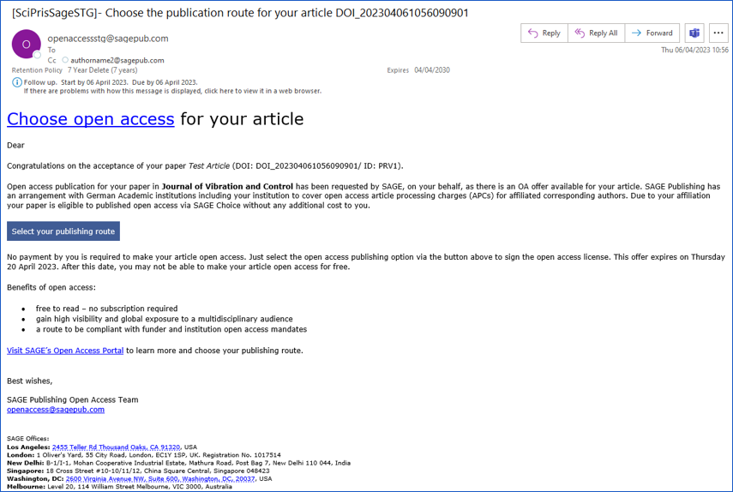
Open Access Offer Email

Slide 4
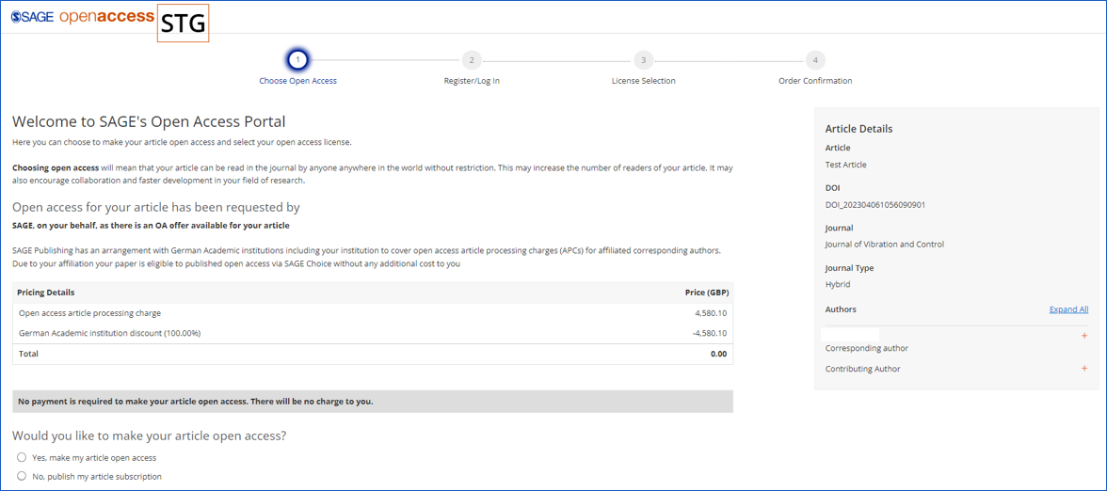
Choose Open Access

Slide 5
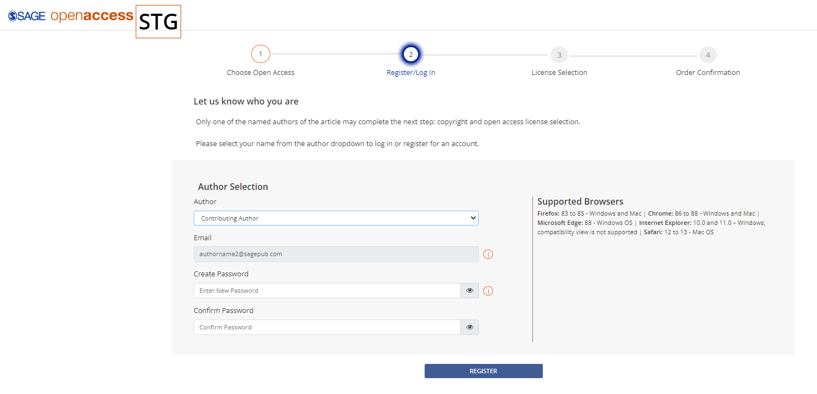
Register/Log In

Slide 6
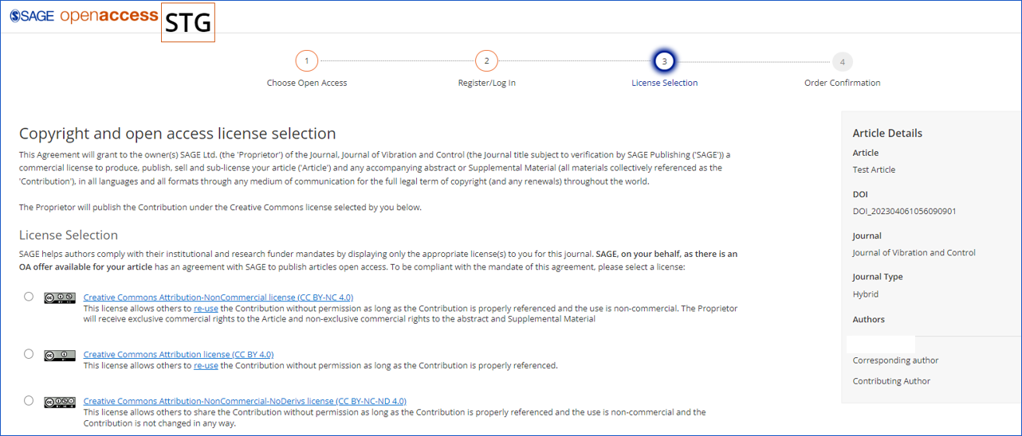
License Selection

Slide 7
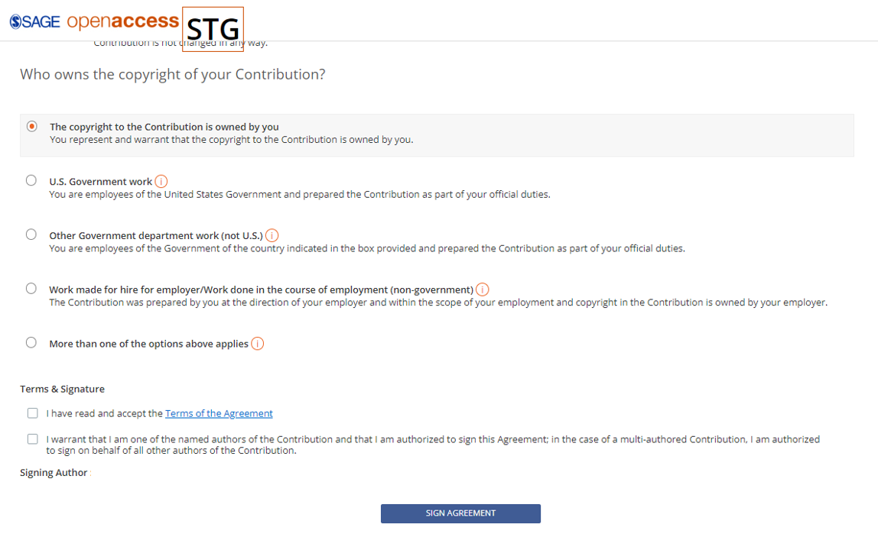
License Selection

Slide 8
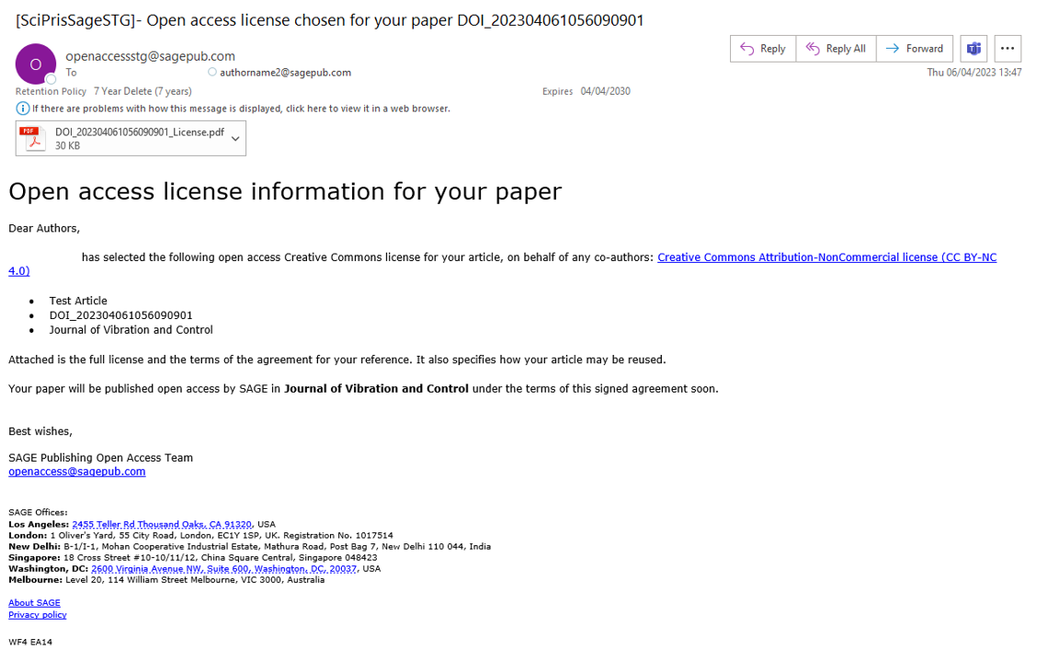
Order Confirmation

Slide 9
Gold Article Workflow

Slide 10
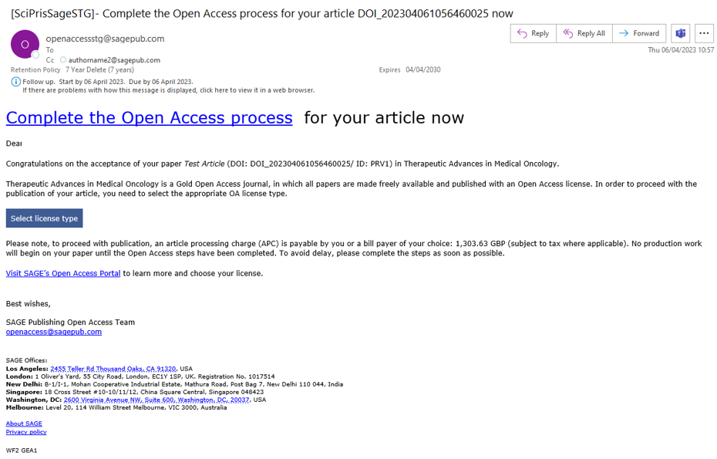
Complete Open Access Process email

Slide 11
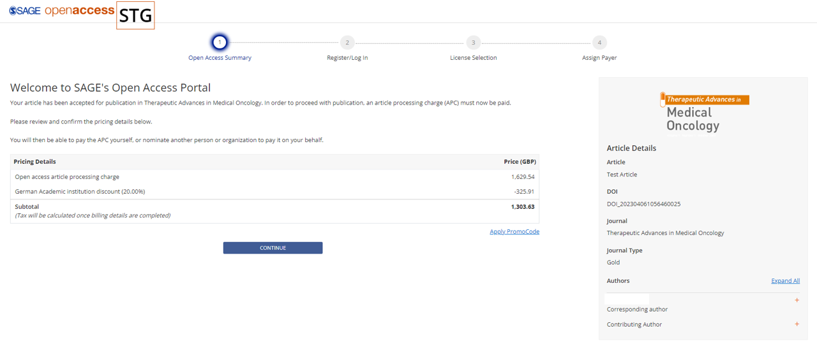
Open Access Summary

Slide 12
Register/Log In

Slide 13
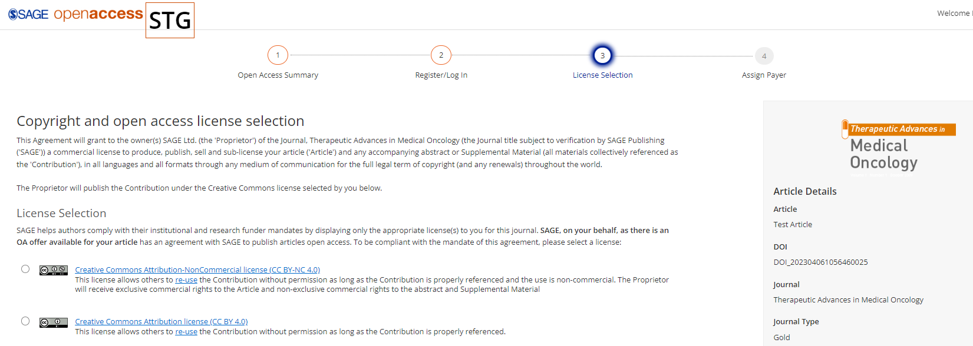
License Selection

Slide 14
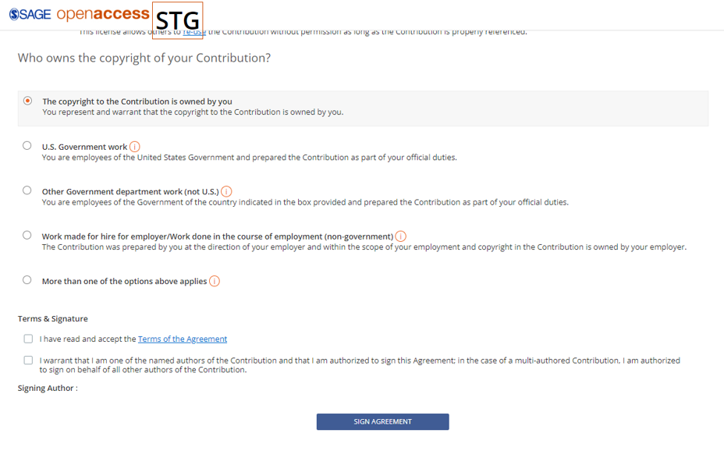
License Selection

Slide 15
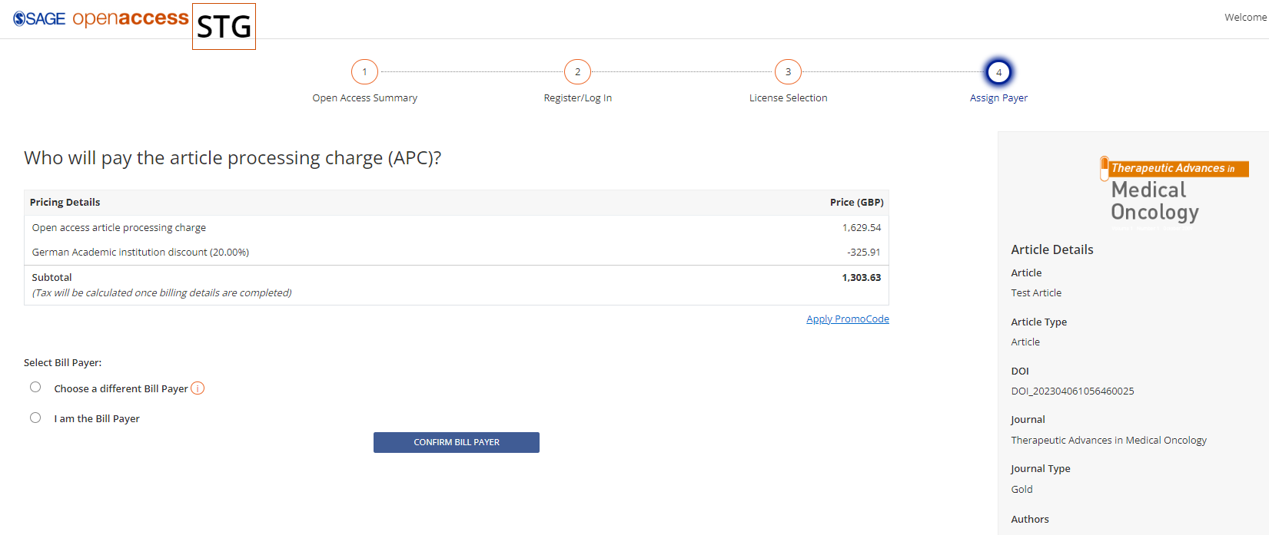
Assign Payer

Slide 16
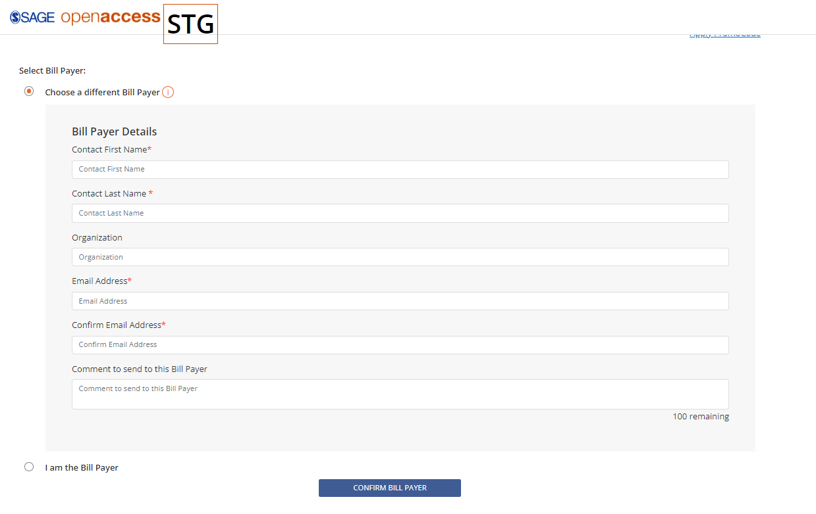
Assign Payer – Option 1 Nominate Bill Payer

Slide 17
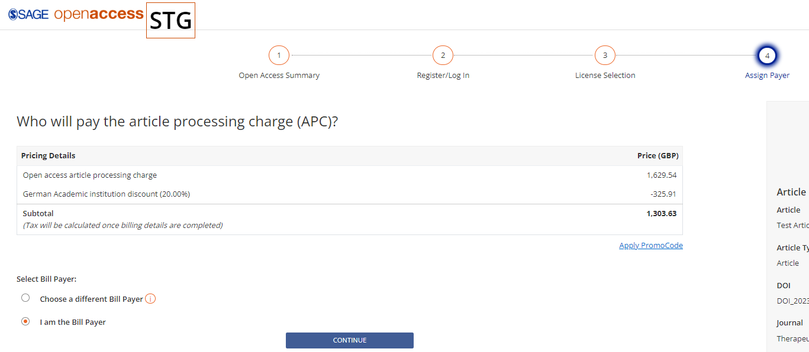
Assign Payer – Option 2 I am the Bill Payer

Slide 18
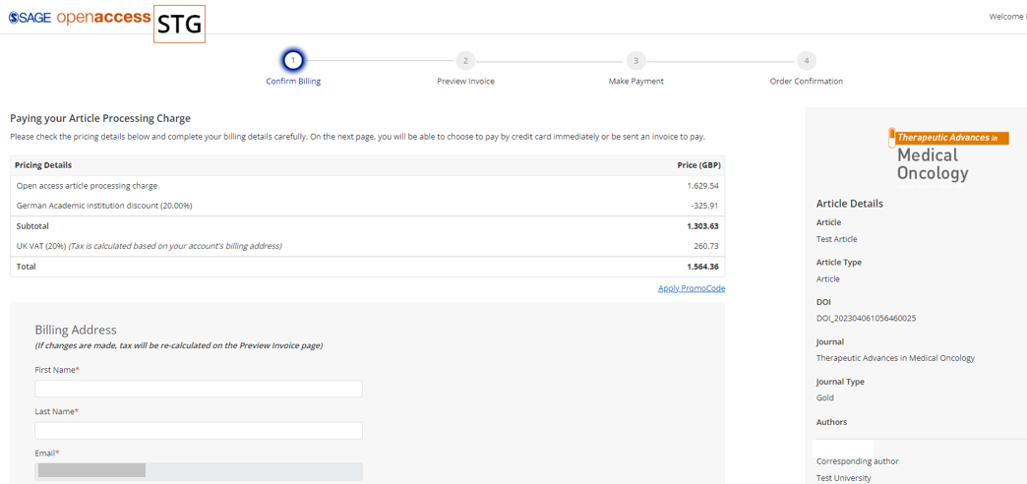
Confirm Billing Details

Slide 19
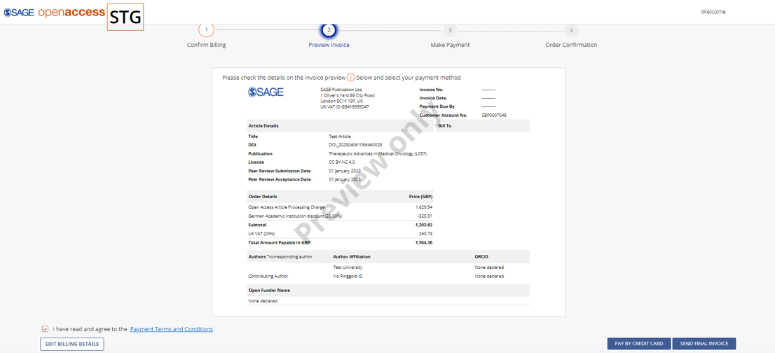
Preview Invoice

Slide 20
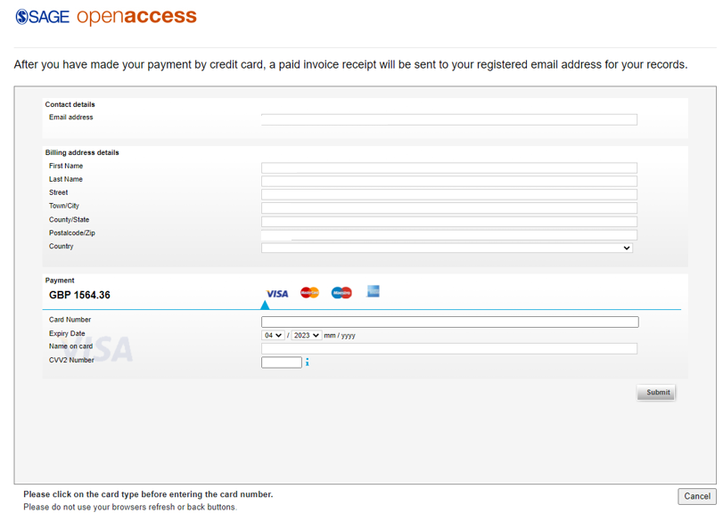
Make Payment – Credit Card Payment

Slide 21
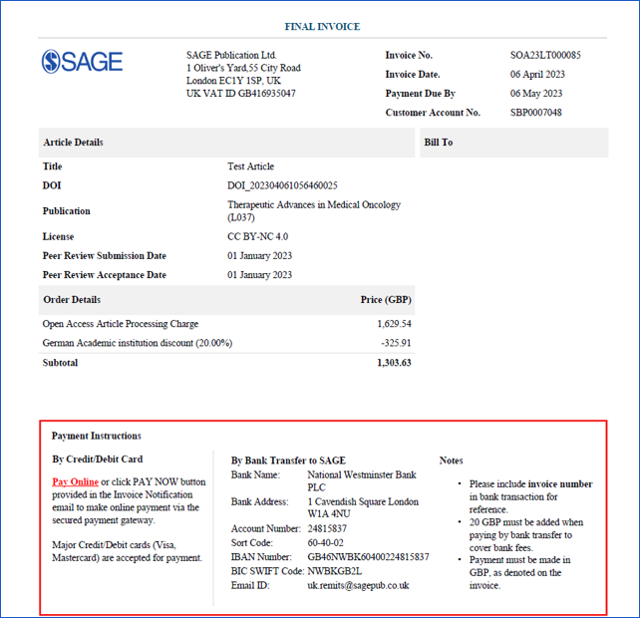
Make Payment – Send Final Invoice (Credit Card or Bank Transfer)

Slide 22
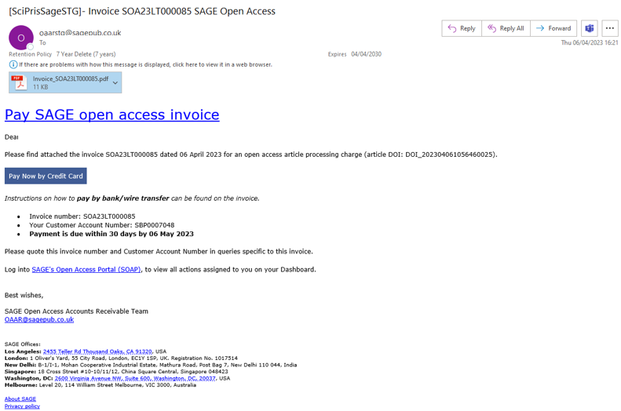
Pay Sage Open Access Invoice

